Slide 1

Lenguaje C avanzado
Dr. Felipe Arias del Campo

Slide 2

Variables
Globales y locales
Strings (cadenas)

Slide 3
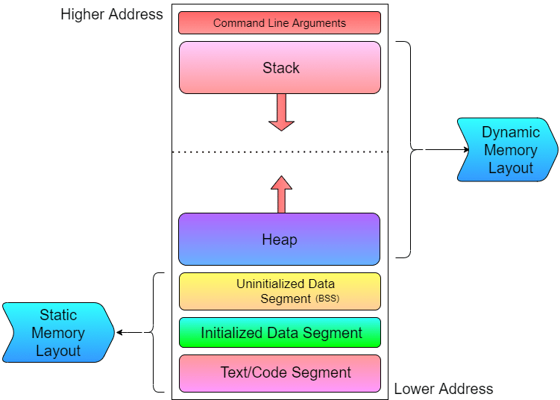
Globales y locales
Fuente: https://hackthedeveloper.com/memory-layout-c-program/

Slide 4

#include <stdio.h>
void MyFunction(void) {
int localA;
int localB;
int localC;
printf("A = %d, B = %d, C = %d\r\n", localA, localB, localC);
localA = 3;
localC = localA + localB;
printf("A = %d, B = %d, C = %d\r\n", localA, localB, localC);
}
int main(void) {
int localA = 4;
int localB = 5;
int localC;
printf("A = %d, B = %d, C = %d\r\n", localA, localB, localC);
localC = localA + localB;
printf("A = %d, B = %d, C = %d\r\n", localA, localB, localC);
MyFunction();
printf("A = %d, B = %d, C = %d\r\n", localA, localB, localC);
}

Slide 5
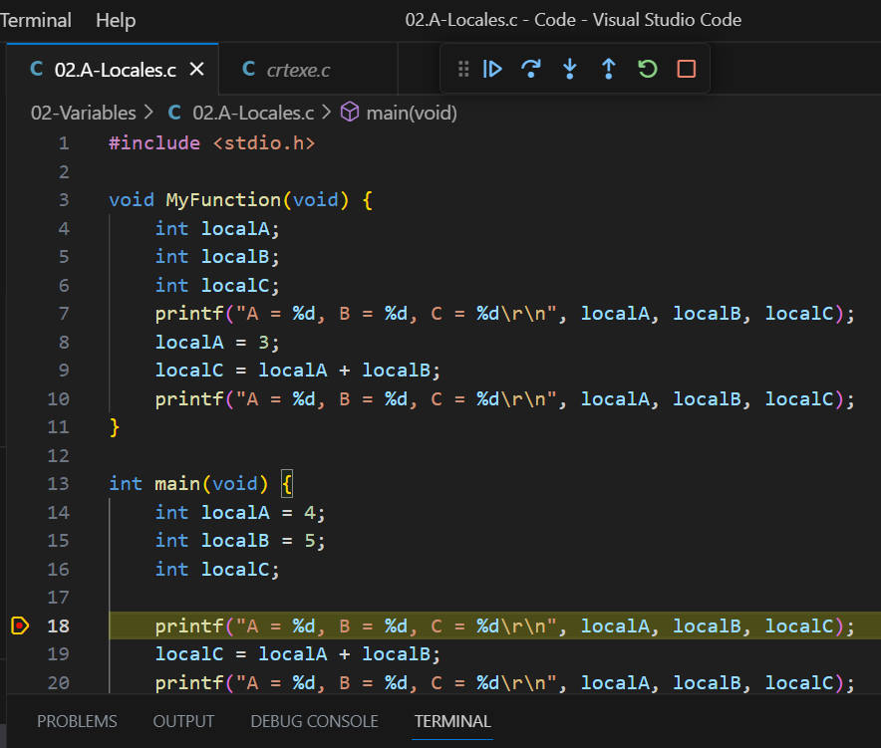
#include <stdio.h>
void MyFunction(void) {
int localA;
int localB;
int localC;
printf("A = %d, B = %d, C = %d\r\n", localA, localB, localC);
localA = 3;
localC = localA + localB;
printf("A = %d, B = %d, C = %d\r\n", localA, localB, localC);
}
int main(void) {
int localA = 4;
int localB = 5;
int localC;
printf("A = %d, B = %d, C = %d\r\n", localA, localB, localC);
localC = localA + localB;
printf("A = %d, B = %d, C = %d\r\n", localA, localB, localC);
MyFunction();
printf("A = %d, B = %d, C = %d\r\n", localA, localB, localC);
}
Continuar
Brincar
Entrar
Reiniciar
Regresar
Detener
Interrupción

Slide 6
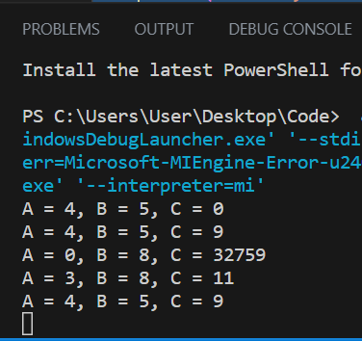
#include <stdio.h>
void MyFunction(void) {
int localA;
int localB;
int localC;
printf("A = %d, B = %d, C = %d\r\n", localA, localB, localC);
localA = 3;
localC = localA + localB;
printf("A = %d, B = %d, C = %d\r\n", localA, localB, localC);
}
int main(void) {
int localA = 4;
int localB = 5;
int localC;
printf("A = %d, B = %d, C = %d\r\n", localA, localB, localC);
localC = localA + localB;
printf("A = %d, B = %d, C = %d\r\n", localA, localB, localC);
MyFunction();
printf("A = %d, B = %d, C = %d\r\n", localA, localB, localC);
}

Slide 7
#include <stdio.h>
void MyFunction(void) {
int localA;
int localB;
int localC;
printf("A = %d, B = %d, C = %d\r\n", localA, localB, localC);
localA = 3;
localC = localA + localB;
printf("A = %d, B = %d, C = %d\r\n", localA, localB, localC);
}
int main(void) {
int localA = 4;
int localB = 5;
int localC;
printf("A = %d, B = %d, C = %d\r\n", localA, localB, localC);
localC = localA + localB;
printf("A = %d, B = %d, C = %d\r\n", localA, localB, localC);
MyFunction();
printf("A = %d, B = %d, C = %d\r\n", localA, localB, localC);
}

Slide 8
#include <stdio.h>
void MyFunction(void) {
int localA;
int localB;
int localC;
printf("A = %d, B = %d, C = %d\r\n", localA, localB, localC);
localA = 3;
localC = localA + localB;
printf("A = %d, B = %d, C = %d\r\n", localA, localB, localC);
}
int main(void) {
int localA = 4;
int localB = 5;
int localC;
printf("A = %d, B = %d, C = %d\r\n", localA, localB, localC);
localC = localA + localB;
printf("A = %d, B = %d, C = %d\r\n", localA, localB, localC);
MyFunction();
printf("A = %d, B = %d, C = %d\r\n", localA, localB, localC);
}

Slide 9
#include <stdio.h>
void MyFunction(void) {
int localA;
int localB;
int localC;
printf("A = %d, B = %d, C = %d\r\n", localA, localB, localC);
localA = 3;
localC = localA + localB;
printf("A = %d, B = %d, C = %d\r\n", localA, localB, localC);
}
int main(void) {
int localA = 4;
int localB = 5;
int localC;
printf("A = %d, B = %d, C = %d\r\n", localA, localB, localC);
localC = localA + localB;
printf("A = %d, B = %d, C = %d\r\n", localA, localB, localC);
MyFunction();
printf("A = %d, B = %d, C = %d\r\n", localA, localB, localC);
}

Slide 10
#include <stdio.h>
void MyFunction(void) {
int localA;
int localB;
int localC;
printf("A = %d, B = %d, C = %d\r\n", localA, localB, localC);
localA = 3;
localC = localA + localB;
printf("A = %d, B = %d, C = %d\r\n", localA, localB, localC);
}
int main(void) {
int localA = 4;
int localB = 5;
int localC;
printf("A = %d, B = %d, C = %d\r\n", localA, localB, localC);
localC = localA + localB;
printf("A = %d, B = %d, C = %d\r\n", localA, localB, localC);
MyFunction();
printf("A = %d, B = %d, C = %d\r\n", localA, localB, localC);
}

Slide 11
#include <stdio.h>
int VariableD;
void MyFunction(void) {
int localA;
int localB;
int localC;
printf("A = %d, B = %d, C = %d D = %d\r\n", localA, localB, localC, VariableD);
localA = 3;
localC = localA + localB;
VariableD = 7;
printf("A = %d, B = %d, C = %d D = %d\r\n", localA, localB, localC, VariableD);
localC = localA + localB + VariableD;
}
int main(void) {
int localA = 4;
int localB = 5;
int localC;
printf("A = %d, B = %d, C = %d D = %d\r\n", localA, localB, localC, VariableD);
localC = localA + localB + VariableD;
printf("A = %d, B = %d, C = %d D = %d\r\n", localA, localB, localC, VariableD);
MyFunction();

Slide 12
MyFunction();
printf("A = %d, B = %d, C = %d D = %d\r\n", localA, localB, localC, VariableD);
localC = localA + localB + VariableD;
printf("A = %d, B = %d, C = %d D = %d\r\n", localA, localB, localC, VariableD);
}

Slide 13
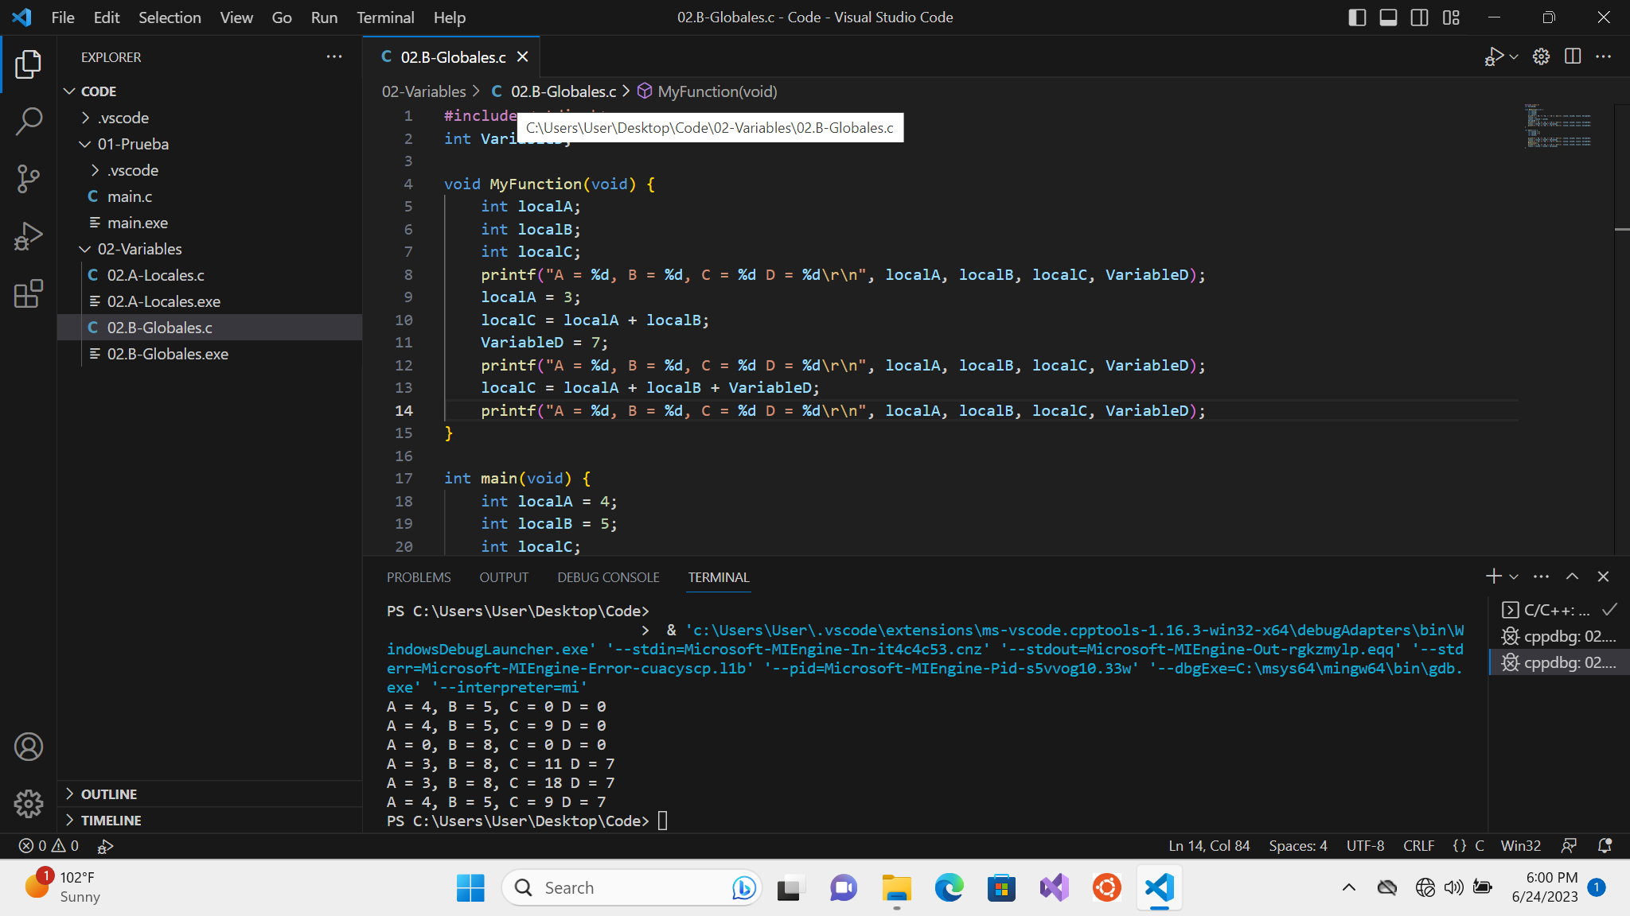

Slide 14
Compilación de un programa en C
¿Cómo se compila un programa?
Partiendo del código fuente.
Se procesa el código por medio de un compilador.
Se obtiene un código intermedio (objeto).
El encadenador (Linker) junta librerías y código objeto.
Se obtiene el código ejecutable.
Fuente.C
Fuente.obj
Programa.exe

Slide 15
Proyecto
Permite dividir el código en diversos archivos.
Facilita la organización del código.
Facilita la creación de programas complejos.
Permite la modularidad y reutilización del código.
A.c
A.h
B.c
B.h
main.c
Programa.exe
C.c
C.h

Slide 16
02.C-Globales.c
#include <stdio.h>
#include "02.C-Library.h"
int VariableD;
int main(void) {
int localA = 4;
int localB = 5;
int localC;
printf("A = %d, B = %d, C = %d D = %d\r\n", localA, localB, localC, VariableD);
localC = localA + localB + VariableD;
printf("A = %d, B = %d, C = %d D = %d\r\n", localA, localB, localC, VariableD);
MyFunction();
printf("A = %d, B = %d, C = %d D = %d\r\n", localA, localB, localC, VariableD);
localC = localA + localB + VariableD;
}

Slide 17
02.C-Library.c
#include <stdio.h>
int VariableD;
void MyFunction(void) {
int localA;
int localB;
int localC;
printf("A = %d, B = %d, C = %d D = %d\r\n", localA, localB, localC, VariableD);
localA = 3;
localC = localA + localB;
VariableD = 7;
printf("A = %d, B = %d, C = %d D = %d\r\n", localA, localB, localC, VariableD);
localC = localA + localB + VariableD;
printf("A = %d, B = %d, C = %d D = %d\r\n", localA, localB, localC, VariableD);
}

Slide 18
02.C-Library.h
void MyFunction(void);

Slide 19
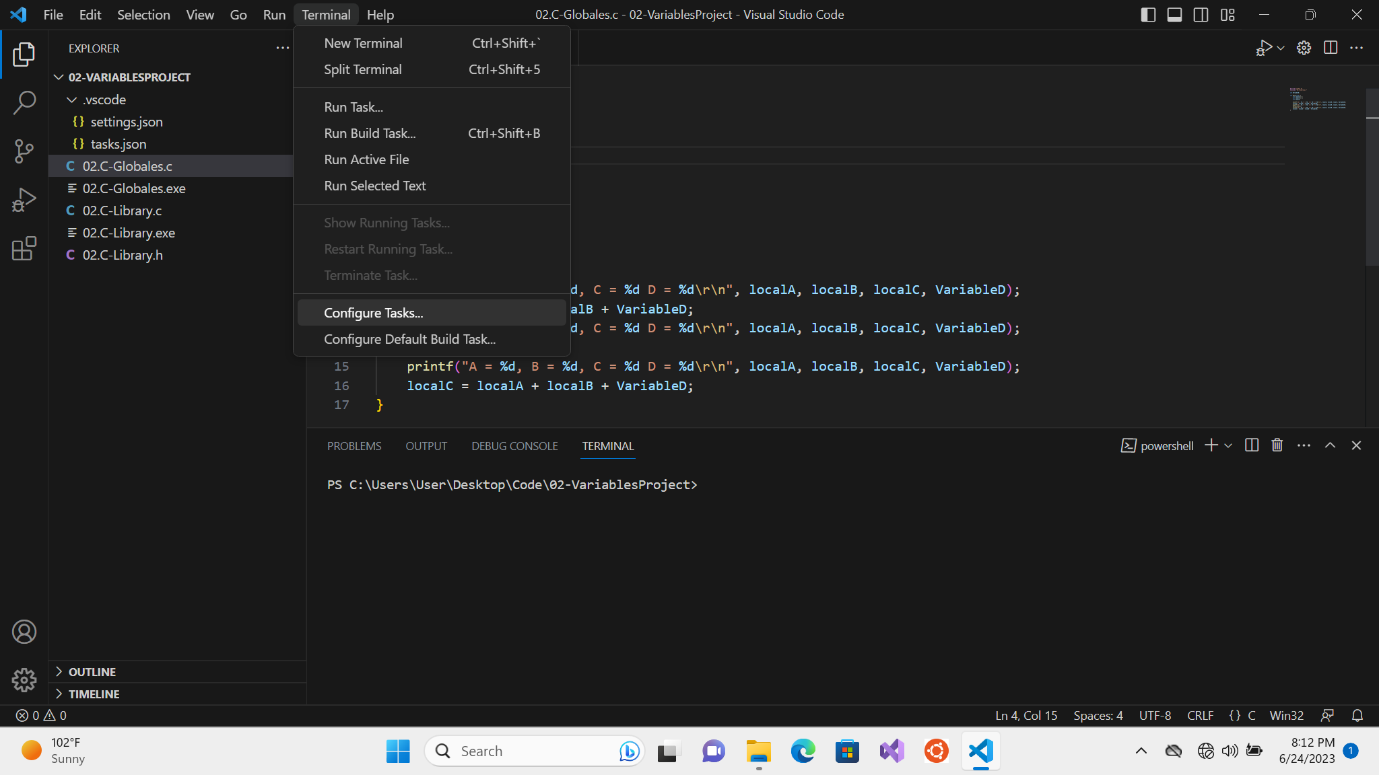
Actualizar la tarea
Abrir la opción de Configure Tasks

Slide 20
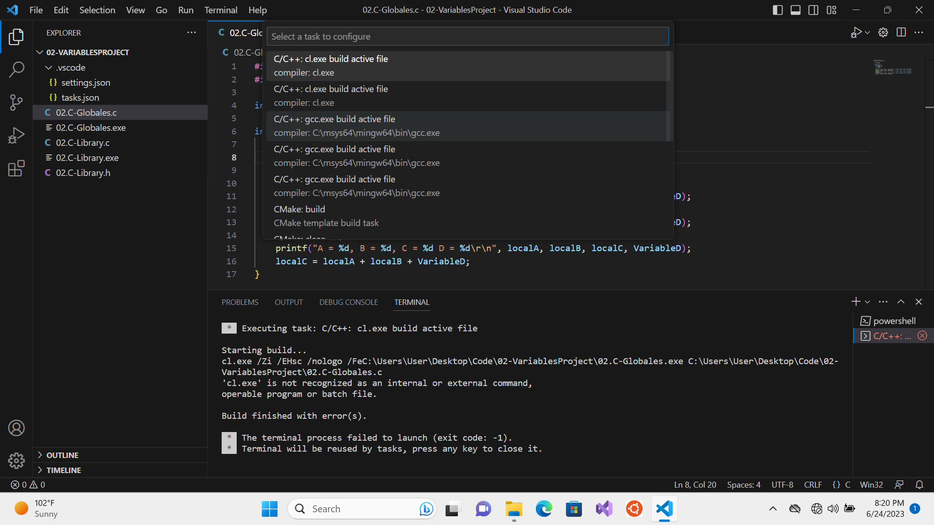
Actualizar la tarea
Abrir la opción de Configure Tasks
Seleccionar C/C++: gcc.exe build active file

Slide 21
Tasks.json
{
"version": "2.0.0",
"tasks": [
{
"type": "cppbuild",
"label": "C/C++: gcc.exe build active file",
"command": "C:\\msys64\\mingw64\\bin\\gcc.exe",
"args": [
"-fdiagnostics-color=always",
"-g",
"${file}",
"-o",
"${fileDirname}\\${fileBasenameNoExtension}.exe"
],
"options": {
"cwd": "${fileDirname}"
},
"problemMatcher": [
"$gcc"
],
"group": "build",
"detail": "compiler: C:\\msys64\\mingw64\\bin\\gcc.exe"
}
]
}
{
"version": "2.0.0",
"tasks": [
{
"type": "cppbuild",
"label": "C/C++: gcc.exe build active file",
"command": "C:\\msys64\\mingw64\\bin\\gcc.exe",
"args": [
"-fdiagnostics-color=always",
"-g",
${workspaceFolder}/*.c",
"-o",
"${fileDirname}\\${fileBasenameNoExtension}.exe"
],
"options": {
"cwd": "${fileDirname}"
},
"problemMatcher": [
"$gcc"
],
"group": "build",
"detail": "compiler: C:\\msys64\\mingw64\\bin\\gcc.exe"
}
]
}

Slide 22
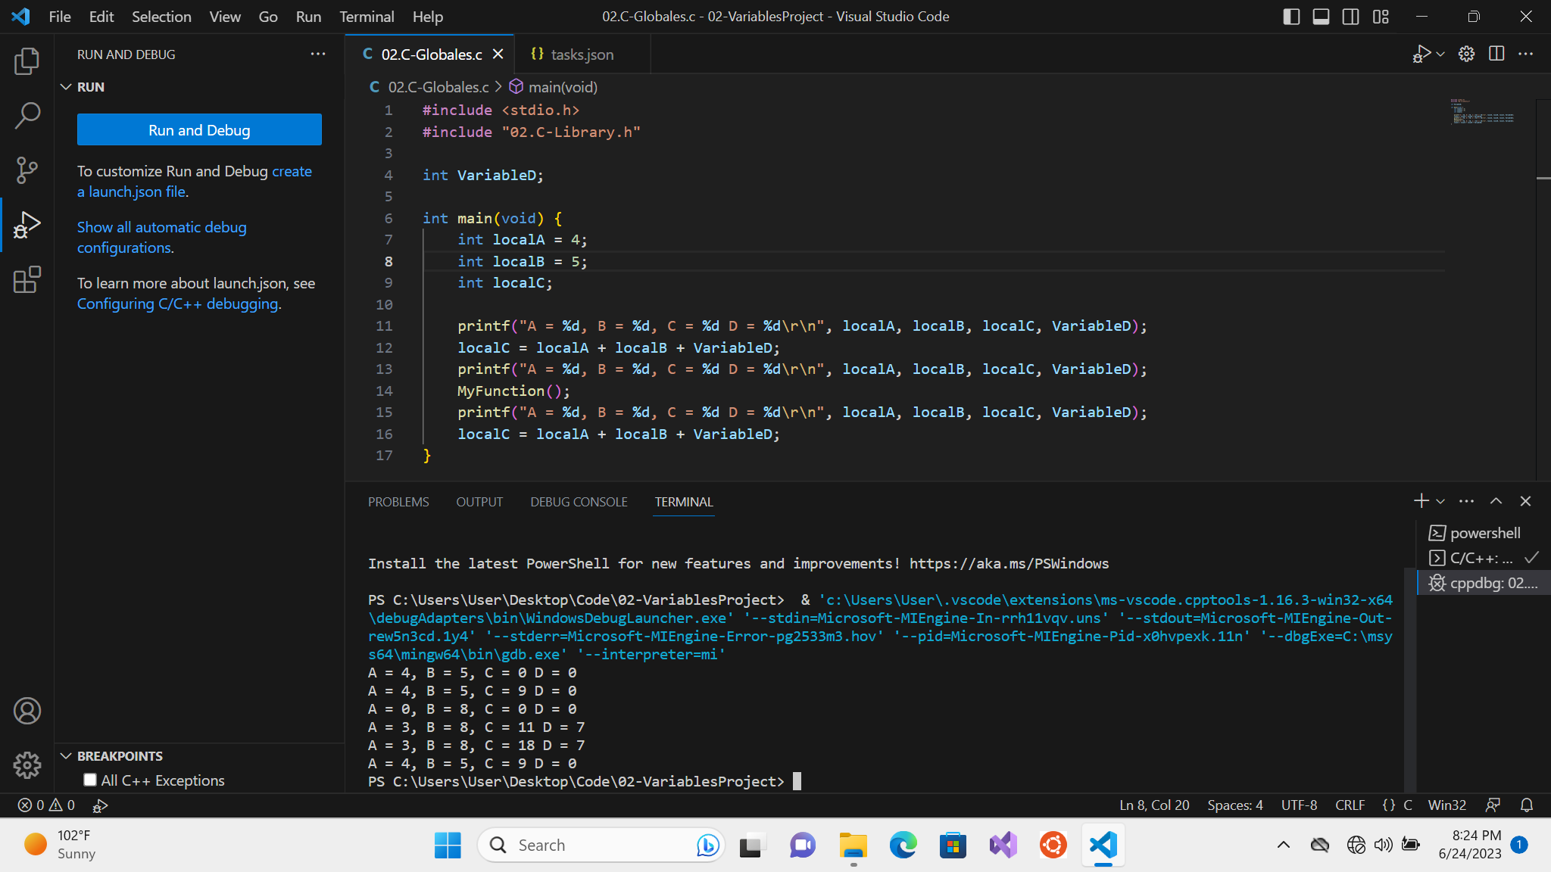

Slide 23

Variables
Variables locales, solo son accesibles dentro de una función.
Variables estáticas, son accesibles globalmente en el mismo archivo.
Variables externas, han sido definidas en otro archivo y son visibles globalmente en el archivo donde se declaran.
Variables globales, son visibles en el archivo, y puede declararse una referencia externa a la misma en otro archivo.
#include <stdio.h>
int VariableD;
static VariableE;
extern variableF
void MyFunction(void) {
int localA;
...
}

Slide 24

Tipos en C
#include <string.h>
#include <stdio.h>
int main(void) {
char text[50];
printf("%s", text);
strcpy(text, "Hola!");
printf("%s", text);
strcat(text, " Ya estamos por terminar!");
printf("%s", text);
strcat(text, "\r\n");
printf("%s", text);
printf("Tenemos %d caracteres en la cadena '%s’”, strlen(text), text);
return 0;
}
Números
Entero, flotante, byte
Caracteres
Caracter
Cadenas de caracteres
No existen
Se implementan como un arreglo de caracteres
No existen manipulaciones directas

